Slide 1
MachineVision Project
Abdul Basit – 20246646

Slide 2
Tasks 01: CNN Classifier
Custom CNN Classifier
Advance CNN Architectures
4-Fold Validation
Comparison

Slide 3
Custom CNN Classifier
Structure:
4 –CNN Layers (kernel size=3, padding=1) , input size = 224*224
Activation Function (ReLU)--max(0,x)
Pooling (Max, 2)--best results
Final feature map size = 16 * 16

Slide 4
Custom CNN Classifier
Classifier (Fully Connected Layers)
Flatten() -- 128 x 16 x 16 into a 1D vector (32768 features)
Linear(32768 → 128 -compresses high-dimensional feature vector to a compact representation
ReLU() + Dropout(0.7)
Linear(128 → 2)-Final output layer for binary classification (2 classes)
Hyper-Parameters:
BATCH_SIZE = 8
EPOCHS = 50
LEARNING_RATE = 0.0003,
criterion = Cross EntropyLoss
Optimizer = Adam

Slide 5
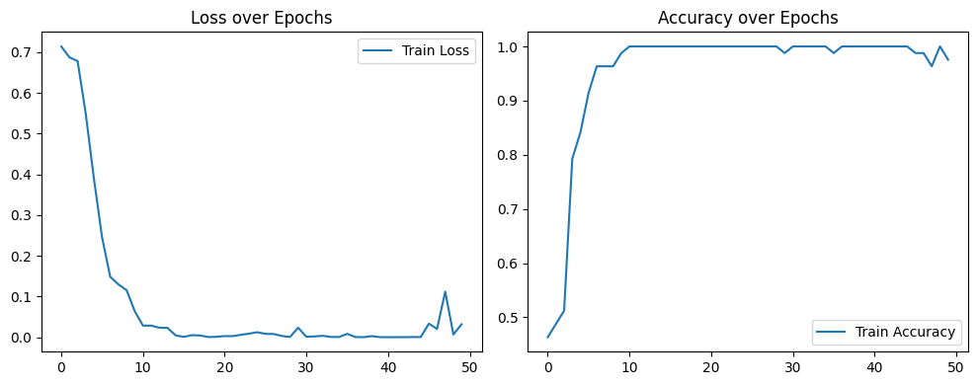
Training Performance

Slide 6
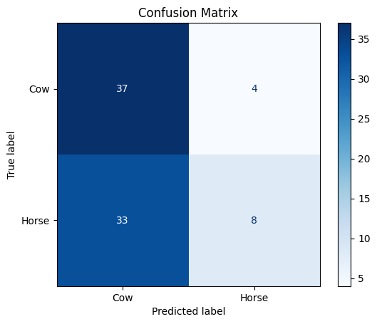
Results
Testing Accuracy = 54.88%

Slide 7
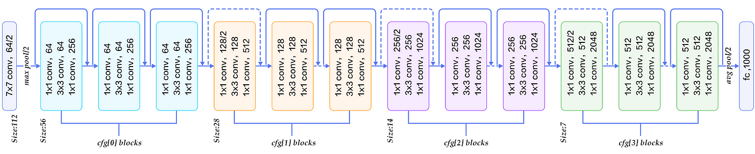
ResNet50
Hyper-Parameters:
Batch size = 32
Epochs = 50
Learning Rate = 0.001
Optimizer = Adam
Cross Entropy Loss
Pretrained = False

Slide 8
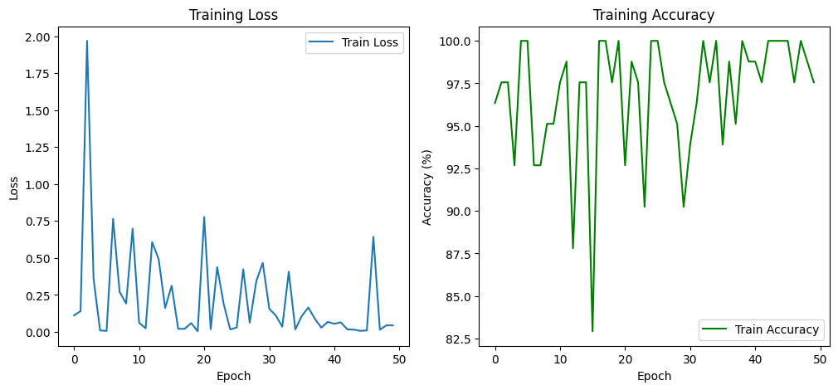
Performance

Slide 9
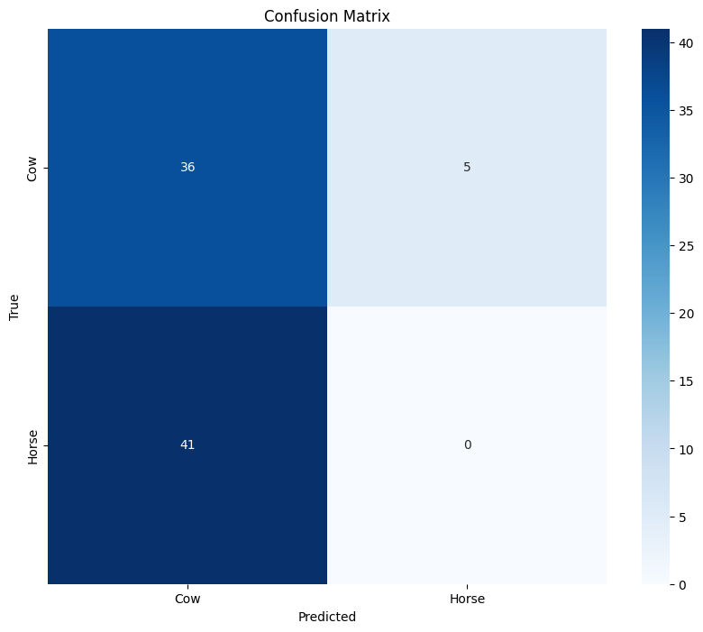
Result
Testing Accuracy = 43.90%

Slide 10
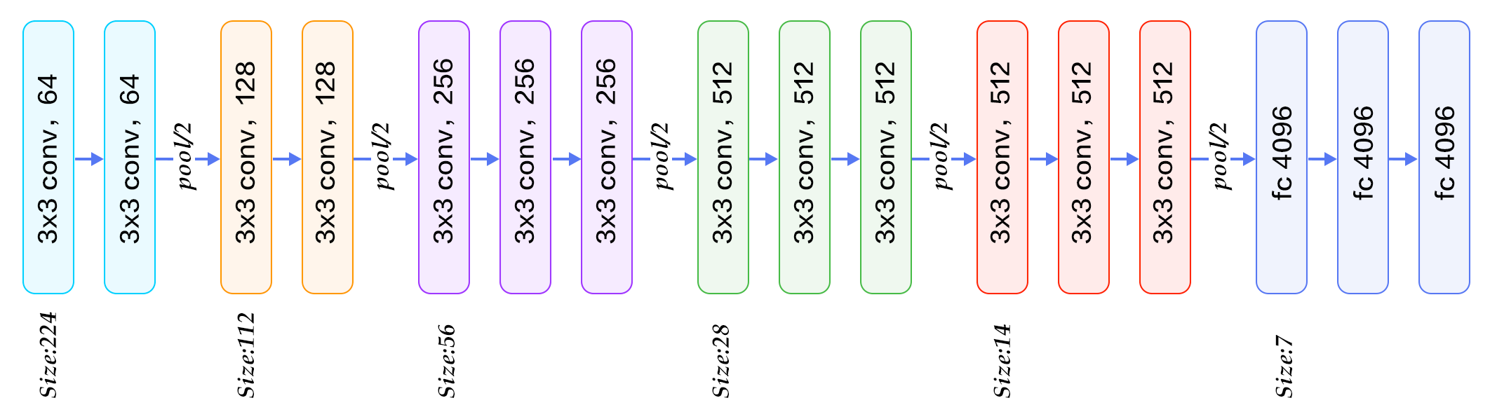
VGG-16
Hyper-Parameters:
Batch size = 32
Epochs = 50
Learning Rate = 0.002
Optimizer = Adam
Cross Entropy Loss
Pretrained = False

Slide 11
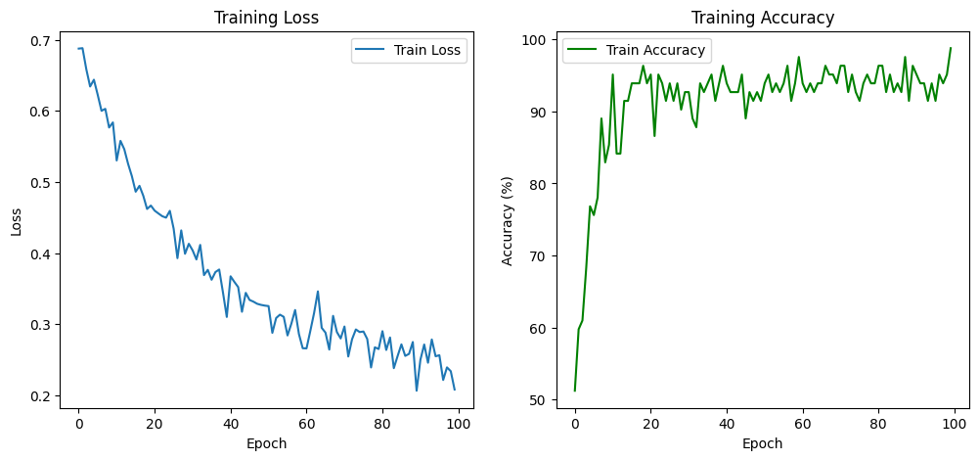
Performance

Slide 12
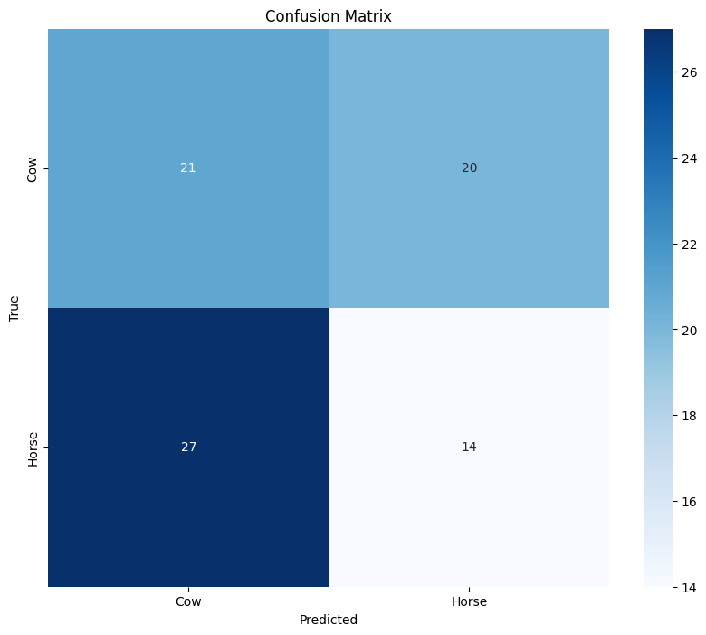
Result
Testing Accuracy = 42.68%

Slide 13
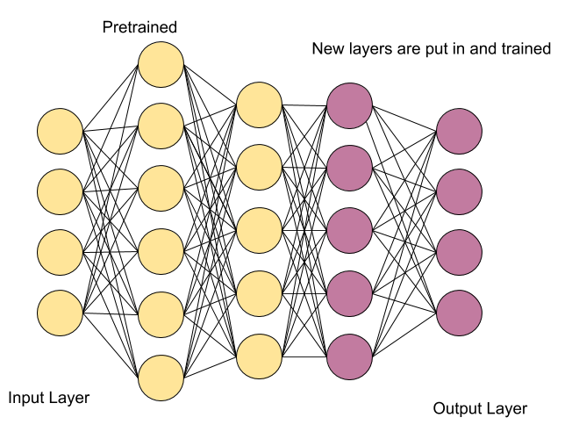
Transfer Learning

Slide 14
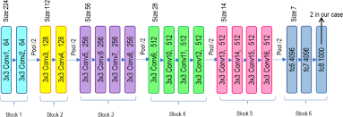
VGG-19
Hyper-Parameters:
Batch size = 32
Epochs = 50
Learning Rate = 0.002
Optimizer = Adam
Cross Entropy Loss
Pretrained = True

Slide 15
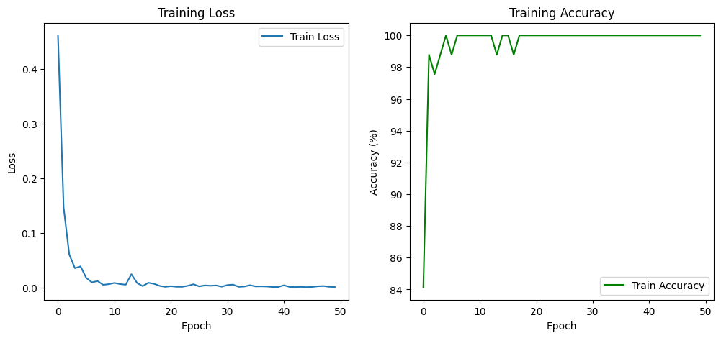
Performance

Slide 16
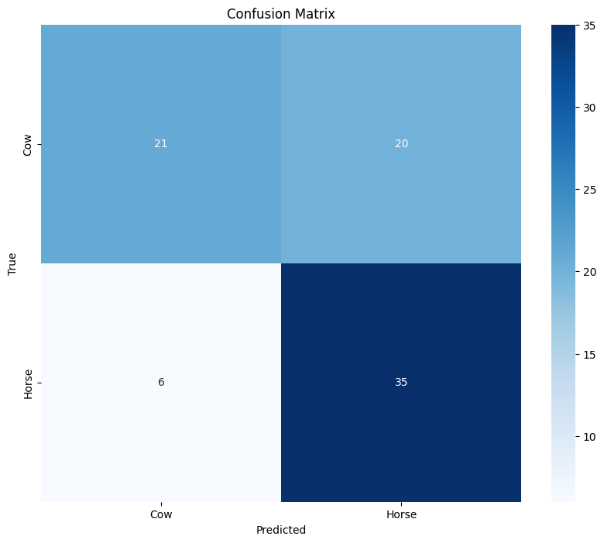
Result
Testing Accuracy = 68.29%

Slide 17
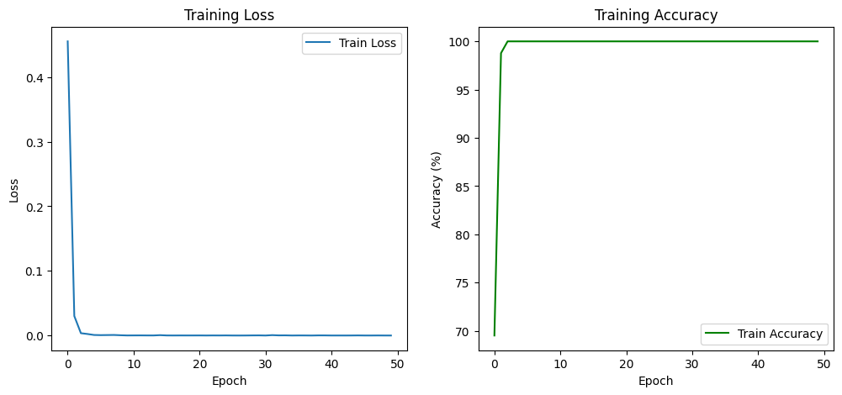
VGG-16

Slide 18
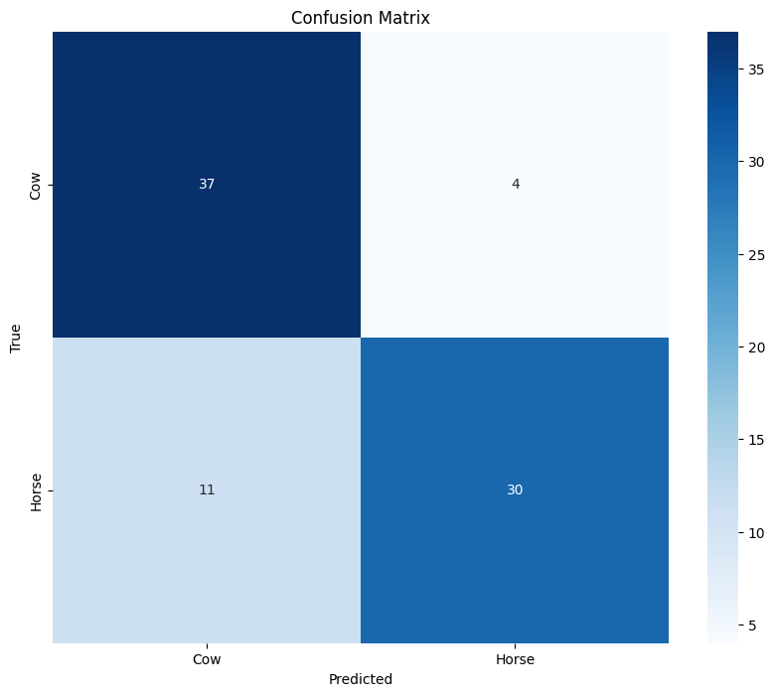
Result
Testing Accuracy = 81.71%

Slide 19
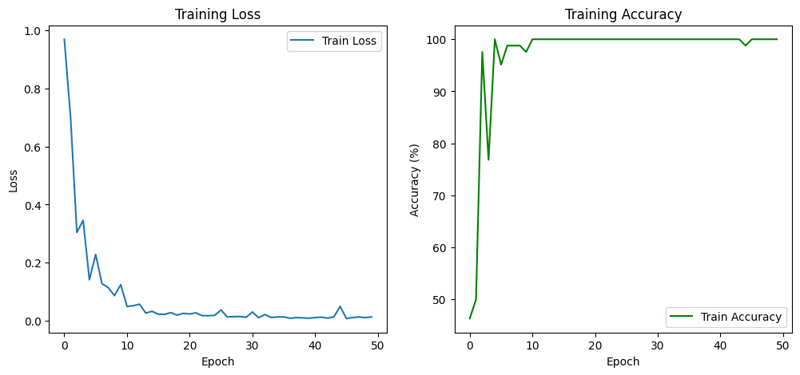
ResNet50

Slide 20
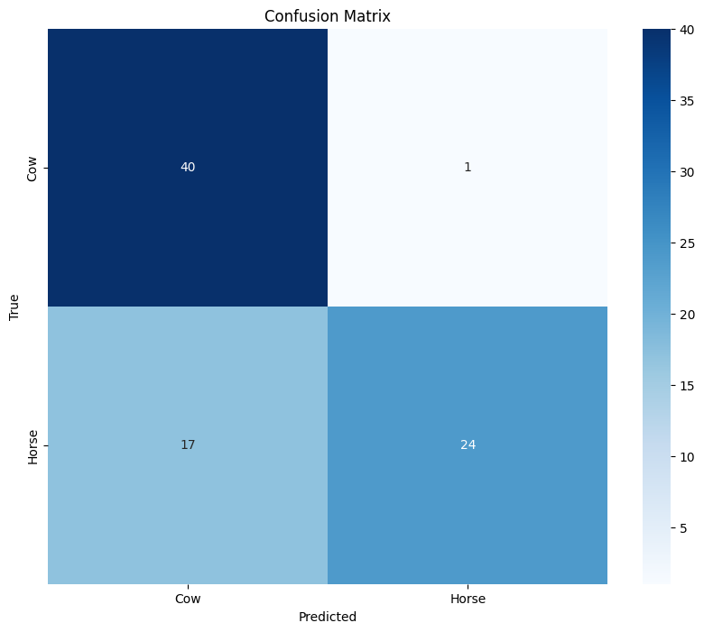
Result
Testing Accuracy = 78.05%

Slide 21
Issue
Train again --- different result
Sometime better but mostly bad
:((

Slide 22
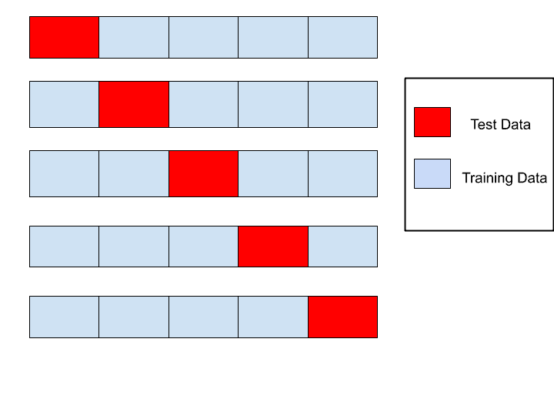
Cross-Validation

Slide 23
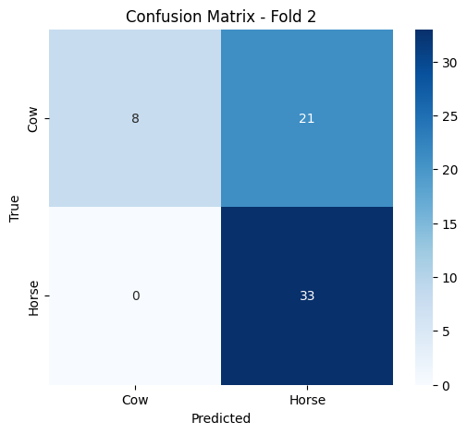
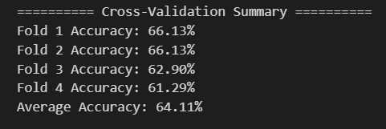
ResNet50

Slide 24
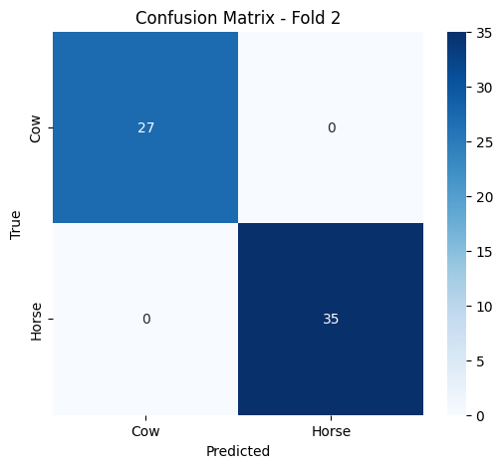
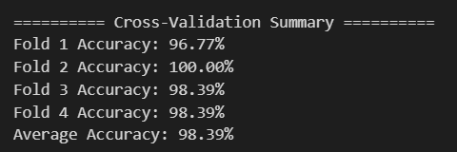
ResNet50

Slide 25
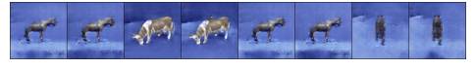
Task 02: Data augmentation
Using GAN
LD​=−Ex∼pdata​(x)​[logD(x)]−Ez∼pz​(z)​[log(1−D(G(z)))]
Generated Images

Slide 26
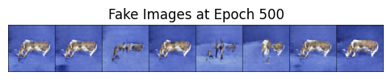
Task 02: Data augmentation
Using GAN with soft labels

Slide 27
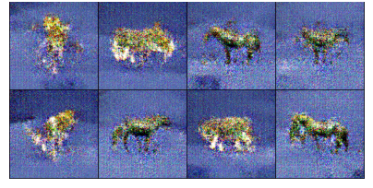
Task 02: Data augmentation
Using Conditional GAN
Generated Images

Slide 28
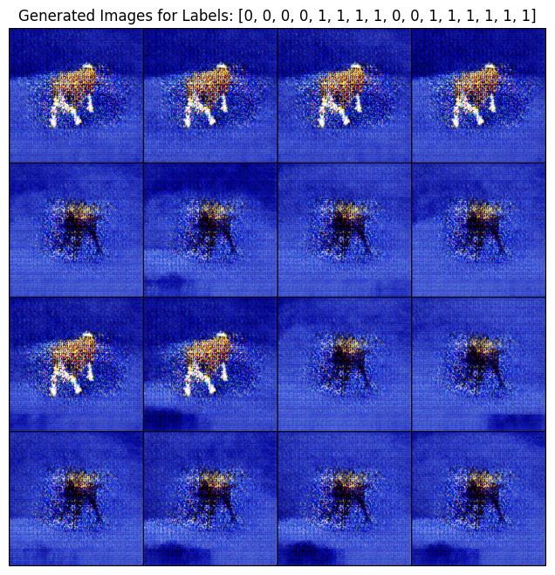
Task 02: Data augmentation
Using Conditional GAN
with progressive growing

Slide 29
Final Task
CNN Classifier including augmented data

Slide 30
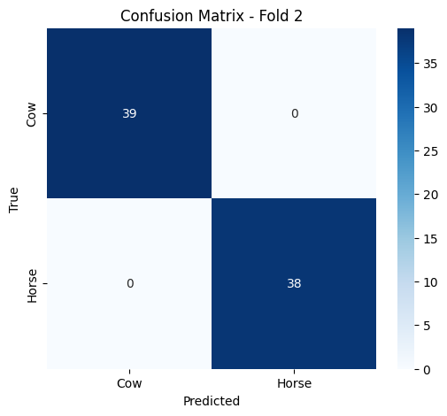
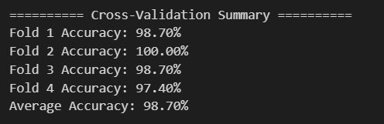
ResNet50

Slide 31
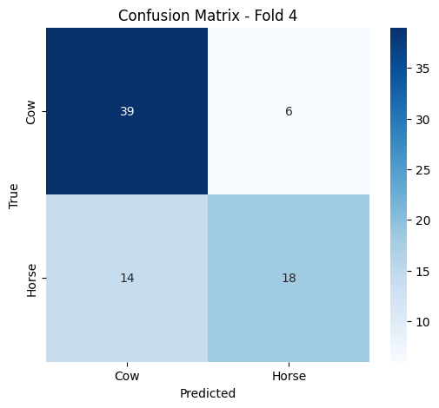
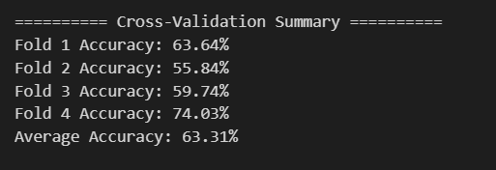
ResNet50
Comparison
1- Best = 66.01, Avg = 64.21
2- Best = 74.03 , Avg = 63.31

Slide 32
Task 03: Style Transferring
Using Cycle GAN
CycleGAN Loss
GAN Loss --Ensures generated images look realistic within their target domain by pitting generators against discriminators.
Cycle Loss -- Forces the translation to be reversible, ensuring that translating an image to the other domain and back yields the original image.
Identity Loss -- Encourages the generator to preserve the input image's when the input already belongs to the target domain.

Slide 33
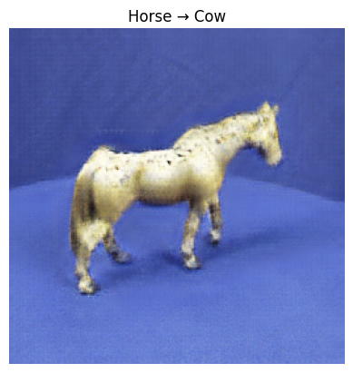
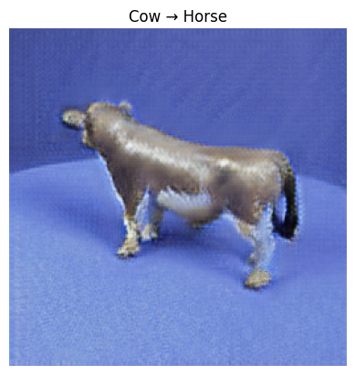
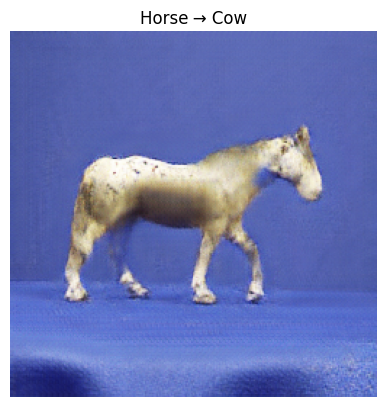
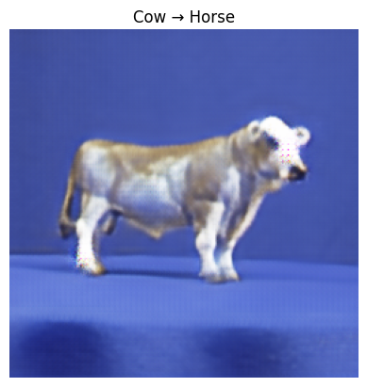
Results

Slide 34
Thank You!
:)

